Slide 1
CompTIA A+ Guide to IT Technical Support
10th Edition

Slide 2
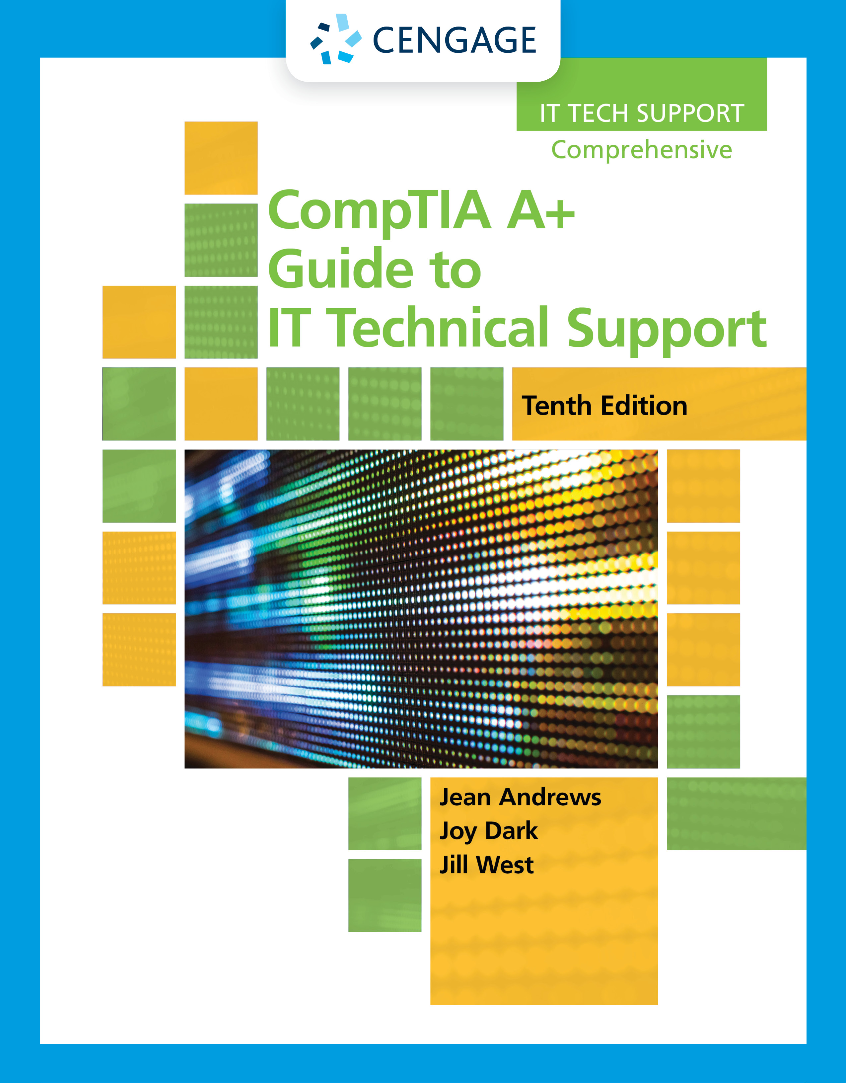
Supporting I/O Devices
Chapter 6

Slide 3
Objectives
Describe the general approach technicians use to install and support I/O devices
Install and configure several I/O devices, such as barcode readers, biometric devices, pay devices, webcams, graphic tablets, signature pads, and touch screens
Install and configure adapter cards
Support the video subsystem, including selecting a monitor and video card and supporting dual monitors
Troubleshoot common problems with I/O devices
Customize a computer system to meet customer needs

Slide 4
Basic Principles for Supporting Devices
I/O or storage devices may be internal or external
Basic principles apply to both internal and external devices:
Every device is controlled by software
Best guide for installation and support is the manufacturer
Some devices need application software to use with the device
A device is no faster than the port/slot it is designed to use
Use an administrator account in Windows
Problems are sometimes solved by updating drivers or firmware
Install only one device at a time
Device Manager (devmgmt.msc):
Primary Windows tool for managing hardware
Using Device Manager you can:
Disable or enable a device, update its drivers, uninstall a device, undo a driver update

Slide 5
Wired and Wireless Connection Standards Used by Peripheral Devices (1 of 2)
Port or Wireless Type | Maximum Speed | Maximum Cable Length or Wireless Range
Thunderbolt 3 | 40 Gbps | Copper cables up to 2 meters; requires USB-C connector
Thunderbolt 2 | 20 Gbps | Copper cables up to 100 meters
SuperSpeed+ USB (USB 3.2) | 20 Gbps | For maximum speed, cable length up to 1 meter; requires USB-C connector
SuperSpeed+ USB (USB 3.1) | 10 Gbps | Cable lengths up to 3 meters
eSATA Version 3 (eSATA-600) | 6.0 Gbps | Cable lengths up to 2 meters
SuperSpeed USB (USB 3.0) | 5.0 Gbps | Cable lengths up to 3 meters
eSATA Version 2 (eSATA-300) | 3.0 Gbps | Cable lengths up to 2 meters
eSATA Version 1 (eSATA-150) | 1.5 Gbps or 1500 Mbps | Cable lengths up to 2 meters
Wi-Fi 802.11ac RF of 5.0 GHz | 1.3 Gbps or 1300 Mbps | Range up to 70 meters

Slide 6
Wired and Wireless Connection Standards Used by Peripheral Devices (2 of 2)
Port or Wireless Type | Maximum Speed | Maximum Cable Length or Wireless Range
Wi-Fi 802.11n | Up to 600 Mbps | Range up to 70 meters
Lightning | 480 Mbps | Cable lengths up to 2 meters
Hi-Speed USB (USB 2.0) | 480 Mbps | Cable lengths up to 5 meters
Original USB (USB 1.1) | 12 Mbps or 1.2 Mbps | Cable lengths up to 3 meters
Wi-Fi 802.11g RF of 2.4 GHz | Up to 54 Mbps | Range up to 100 meters
Wi-Fi 802.11a RF of 5.0 GHz | Up to 54 Mbps | Range up to 50 meters
Wi-Fi 802.11b RF of 2.4 GHz | Up to 11 Mbps | Range up to 100 meters
Bluetooth wireless RF of 2.45 GHz | Up to 3 Mbps | Range up to 10 meters
Near Field Communication (NFC) RF of 13.56 MHz | Up to 424 kbps | Range up to 4 centimeters

Slide 7
Connectors and Ports Used by Peripheral Devices (1 of 8)
USB Connections and Ports
As many as 127 USB devices can be daisy chained together
USB uses serial transmissions and devices are hot-swappable (plug and unplug without powering down)
A USB cable has four wires, two for power and two for communication

Slide 8

Connectors and Ports Used by Peripheral Devices (2 of 8)
Figure 6-1 SuperSpeed+, SuperSpeed, Hi-Speed, and Original USB logos appear on products certified by the USB Forum

Slide 9
Connectors and Ports Used by Peripheral Devices (3 of 8)
Video Connectors and Ports
Video ports are provided by a video card or the motherboard
Video cards are sometimes called:
Graphic adapters, graphics cards, or display cards
Most motherboards sold today have one or more onboard video ports
Types of video ports:
VGA
DVI
DisplayPort
HDMI and HDMI mini

Slide 10
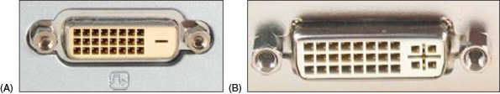
Connectors and Ports Used by Peripheral Devices (4 of 8)
Figure 6-3 Two types of DVI ports: (A) DVI-D, (B) DVI-I

Slide 11
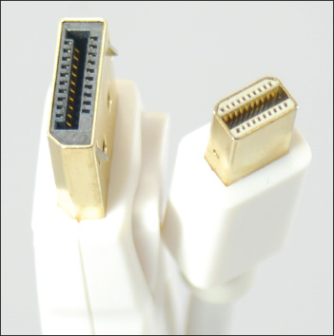
Connectors and Ports Used by Peripheral Devices (5 of 8)
Figure 6-5 A DisplayPort to Mini DisplayPort cable

Slide 12
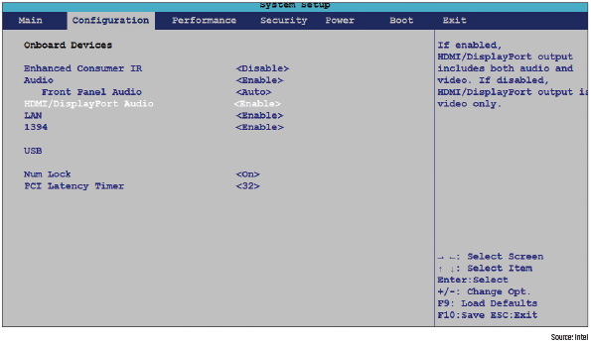
Connectors and Ports Used by Peripheral Devices (6 of 8)
Figure 6-6 Use BIOS/UEFI setup to enable or disable onboard ports

Slide 13
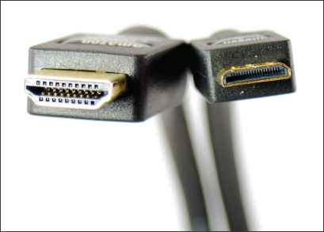
Connectors and Ports Used by Peripheral Devices (7 of 8)
Figure 6-7 An HDMI to mini-HDMI cable

Slide 14
Connectors and Ports Used by Peripheral Devices (8 of 8)
Additional Connectors and Ports
Thunderbolt is a multipurpose connector used for high-end displays, external storage devices, and to charge power for smartphones and laptops
eSATA port is used for connecting external storage devices to a computer
Lightning connector is an Apple-specific connector for its mobile devices
BNC, RG-6, and RG-50
Connectors for coaxial cable
RS-232 connectors have been replaced primarily by USB or other connectors

Slide 15
Identifying and Installing I/O Peripheral Devices
Simple input devices (mouse and keyboard) can be controlled by the BIOS/UEFI or have embedded drivers built into the OS
General procedures to install any peripheral device:
1. Read the manufacturer’s directions
2. Make sure the drivers are written for the proper OS
3. Make sure the motherboard port you are using is enabled
4. Install drivers or plug in the device
5. Install the application software to use the device

Slide 16
Mouse or Keyboard (1 of 4)
Plug a mouse or keyboard into a USB and Windows should automatically recognize it and install generic drivers
Older PS/2 ports are not hot-pluggable, so you must restart Windows after plugging into this type of port
For keyboards with special features:
Install drivers that came with the keyboard
Use Device Manager to uninstall, disable, or enable most devices
USB devices are managed through Programs and Features window

Slide 17
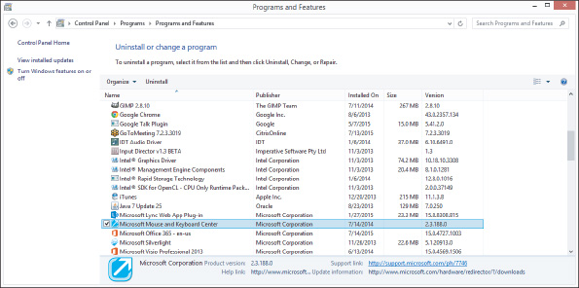
Mouse or Keyboard (2 of 4)
Figure 6-17 USB devices are listed as installed programs

Slide 18
Mouse or Keyboard (3 of 4)
Replace the Keyboard and Touch Pad in a Laptop
Power down the laptop and remove AC adapter and battery pack
Remove screws on bottom of laptop
Turn the laptop over and open lid
Push keyboard toward lid while pulling it up to release it from the case
Bring keyboard out of the case and forward
Expose keyboard ribbon cable
Use spudger or tweezers to lift cable connector up and out
Replace keyboard following steps in reverse order
If touchpad is part of keyboard bezel, remove keyboard before removing the keyboard bezel

Slide 19
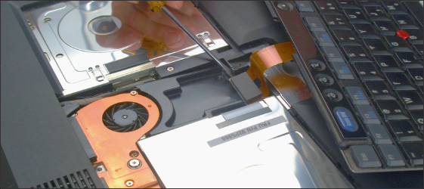
Mouse or Keyboard (4 of 4)
Figure 6-20 Disconnect the keyboard cable from the motherboard

Slide 20
Barcode Readers
Barcode readers are used to scan barcodes on products at point of sale (POS)
Several interface methods:
Wireless connection, serial port, USB port, or keyboard port
If the reader uses a keyboard port:
It most likely contains a splitter (keyboard wedge) for the keyboard to use, and data read by the barcode reader is input into the system

Slide 21
Pay Devices
A magnetic stripe reader and chip reader can read from the stripe or chip to pull information from a card or license
Sends information to the computer through a serial connection, USB connection, Lightning connection, 3.5-mm headphone jack, or a stripe reader wedge mounted on a keyboard
A tap pay device connects wirelessly or by cable to a computer or mobile device to turn it into a point-of-sale system

Slide 22
Signature Pads
A signature pad uses a sensitive touch screen to capture a handwritten signature made using a stylus or finger for a receipt, contract, or ID card
The signature pad LCD panel displays electronic ink
Signature pads typically use a serial or USB connection and include software installed on the computer to process the signature

Slide 23
Biometric Devices (1 of 2)
A biometric device inputs biological data about a person to identify the person’s fingerprint, handprint, face, voice, eye, or handwritten signature
Fingerprint readers may:
Look like a mouse
Use wireless or USB connection
Be embedded on the side of a keyboard, flash drive or laptop
Read documentation to know if you should install drivers before plugging in device

Slide 24
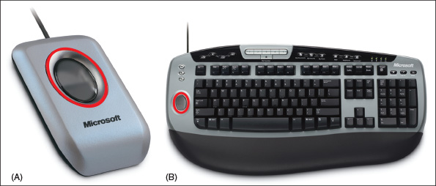
Biometric Devices (2 of 2)
Figure 6-25 Fingerprint readers can (A) look like a mouse, or (B) be embedded on a keyboard

Slide 25
Webcams (1 of 2)
A webcam (web camera):
Is embedded on most laptops
Can be installed using a USB port or other port
Comes with built-in microphone
Use this microphone or use the microphone port on the computer
Use the setup CD to install the software and then plug in the webcam to a USB port

Slide 26
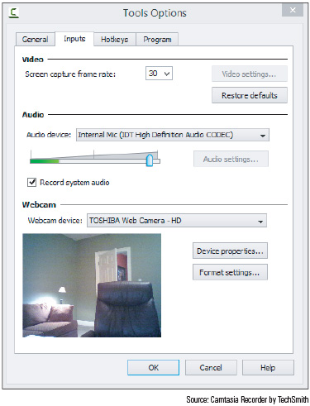
Webcams (2 of 2)
Figure 6-27 The Camtasia Recorder application allows you to change the input devices used for video and sound

Slide 27
Graphics Tablets
A graphics tablet (also called digitizing tablet) is used to hand draw
Likely to connect by a USB port
Comes with stylus that works like a pencil
A graphics tablet and stylus can be a replacement for a mouse or touch pad
Popular with graphic artists and others who use desktop publishing applications
Install the same way as other USB devices

Slide 28
Touch Screens
A touch screen is an input device that uses a monitor or LCD panel as the backdrop for input options
Some laptops and monitors for desktops have built-in touch screens
Can be installed as an add-on
For most installations, install drivers before connecting by way of a USB port
Use management software that came with the device to control and calibrate

Slide 29
Virtual Reality Headsets
A VR (virtual reality) headset is a device worn on the head that creates a visual and audible virtual experience for the user using a lens display, speakers, microphone, and head-tracking sensors for interaction
Often used for extreme gaming and military training
VR headsets can be programmed independently of a computer
Or the headset can be connected to a computer using USB for more programming input or recording the experience
Some VR headsets include a dock for a smartphone

Slide 30
KVM Switches
A KVM (Keyboard, Video, and Mouse) switch allows the use of one keyboard, mouse, and monitor for multiple computers
Useful in a server room or testing lab
Does not require device drivers, just plug in cables form each computer to the device
Switch between computers by using a hot key on the keyboard, buttons on KVM switch, or a wired remote

Slide 31
Installing and Configuring Adapter Cards (1 of 3)
When preparing to install an adapter card:
Verify that the card fits an empty expansion slot
Verify that the device drivers for the OS are available
Back up important data not already backed up
Know your starting point
General directions to install an adapter card
Read the documentation for the card
If replacing an onboard port, disable port in BIOS/UEFI setup
Wear ESD strap, shut down system, unplug power cords and cables, and drain power
Locate slot and prepare for installation

Slide 32
Installing and Configuring Adapter Cards (2 of 3)
General directions to install an adapter card (continued)
Insert card into expansion slot
Anchor card to top of the slot with screws
Connect any power cords or data cables
Replace the case cover, plug in any essential peripherals
Start the system – Windows should detect a new hardware device and attempt to automatically install the drivers
If a CD came with the device, insert and run the setup program
You may have to restart the system
If there are any problems with installation, turn to Device Manager to troubleshoot

Slide 33
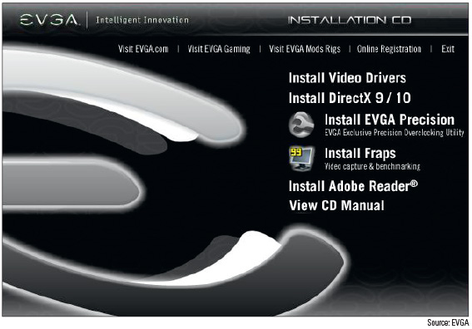
Installing and Configuring Adapter Cards (3 of 3)
Figure 6-35 An opening menu to install video drivers

Slide 34
Sound Cards and Onboard Sound (1 of 2)
A sound card or onboard sound can play and record sound and save it in a file
Color-coded speaker ports are for speakers and subwoofer
Ports may also be available to connect to external sound equipment such as a CD or DVD player

Slide 35
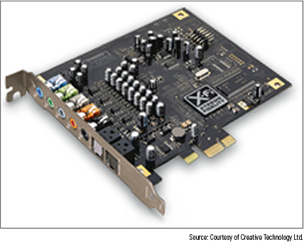
Sound Cards and Onboard Sound (2 of 2)
Figure 6-36 The Sound Blaster X-Fi Titanium sound card by Creative uses a PCIe x1 slot

Slide 36
Replacing Expansion Cards in a Laptop (1 of 3)
Newer laptops are likely to use Mini PCI Express slots (Mini PCIe)
Uses 52 pins on the edge connector
Older notebooks use a Mini PCI slot
For many laptops, remove a cover on the bottom of the laptop to expose expansion cards
For cards that have an antenna, be sure to remove the antenna wires before replacing card
Use Device Manager to ensure the device is working properly after install

Slide 37
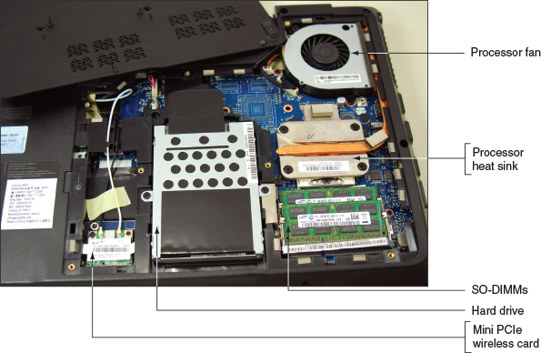
Replacing Expansion Cards in a Laptop (2 of 3)
Figure 6-38 Removing the cover from the bottom of a laptop exposes several internal components

Slide 38
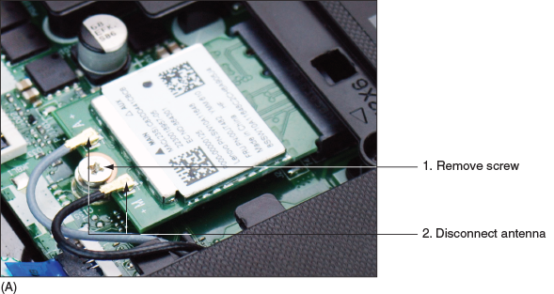
Replacing Expansion Cards in a Laptop (3 of 3)
Figure 6-40 How to remove a Mini PCI Express card

Slide 39
Supporting the Video Subsystem
A monitor is the primary output device of a computer
Two necessary components for video output:
Monitor
Video card (also called video adapter or graphics card) or video port on motherboard

Slide 40
Monitor Technologies and Features (1 of 5)
Types of monitors:
LCD (liquid crystal display) - also called a flat-panel monitor
First used in laptops
At the center of layers is liquid crystal material
Layers are sandwiched between two grids of electrodes forming columns and rows
Each intersection of row and column forms a pixel
OLED (organic light-emitting Diode) monitor uses a thin LED (light-emitting diode) layer or film between two grids of electrodes and does not use backlighting
Does not emit as much light as an LCD monitor, therefore, can produce deeper blacks, provide better contrast, work in darker rooms, and use less power than an LCD monitor
Projector – used to shine a light that projects a transparent image onto a large screen

Slide 41
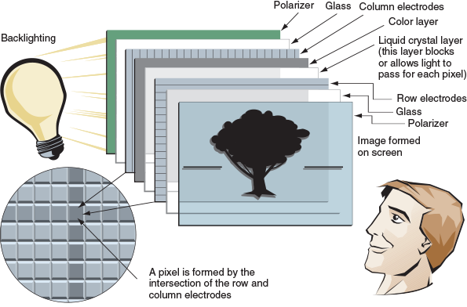
Monitor Technologies and Features (2 of 5)
Figure 6-42 Layers of an LCD panel

Slide 42
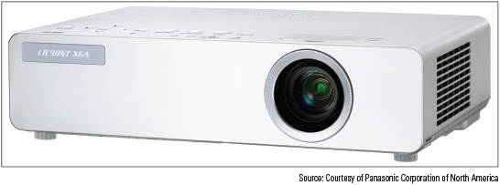
Monitor Technologies and Features (3 of 5)
Figure 6-43 A portable XGA projector by Panasonic

Slide 43
Monitor Technologies and Features (4 of 5)
Monitor Characteristic | Description
Screen size | The screen size is the diagonal length of the screen surface in inches.
Refresh rate | The refresh rate is the number of times a monitor screen is built or refreshed in 1 second, measured in Hz (cycles per second).
Pixel pitch | A pixel is a spot or dot on the screen that can be addressed by software. The pixel pitch is the distance between adjacent pixels on the screen-the smaller the number, the better.
Resolution | The resolution is the number of spots or pixels on a screen that can be addressed by software.
Contrast ratio | Contrast ratio is the contrast between true black and true white on the screen-the higher the contrast ratio, the better.
Viewing angle | The viewing angle is the angle at which a monitor becomes difficult to see from the side.
Backlighting or brightness | Brightness is measured in cd/m² , which is the same as lumens/m² .
Connectors | Popular options for connectors are VGA, DVI-I, DVI-D, HDMI, DisplayPort, and Apple’s Thunderbolt.
Other features | LCD monitors can also provide a privacy or antiglare surface, tilt screens, microphone input, speakers, USB ports, adjustable stands, and perhaps even an input for your smartphone.

Slide 44
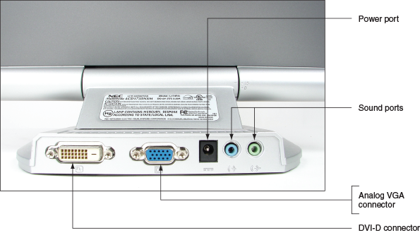
Monitor Technologies and Features (5 of 5)
Figure 6-45 The rear of this LCD monitor shows digital and analog video ports to accommodate a video cable with either a 15-pin analog VGA connector or a digital DVI connector

Slide 45
Changing Monitor Settings
Settings that apply to the monitor can be managed by using the monitor buttons, function keys on a keyboard, and Windows utilities
Using the monitor buttons, you can:
Adjust horizontal and vertical position of the screen
Change the brightness and contrast settings
On laptops, function keys are usually used instead of buttons
Windows utilities can also be used to change monitor settings

Slide 46
Troubleshooting I/O Devices
When troubleshooting peripheral devices:
Always try the least invasive and least expensive solutions first
This section covers how to handle some of the errors or problems you might encounter

Slide 47
NumLock Indicator Light
When users complain that they cannot sign in to Windows even when entering the correct password:
Have them make sure the NumLock key is set correctly
Laptops use this key to toggle between the keys interpreted as letters and numbers
Most laptops have a NumLock indicator light near the keyboard

Slide 48
Device Manager (1 of 2)
Device Manager is usually a good place to start troubleshooting
To see a device’s properties box, right-click the device and click Properties
Try updating the drivers
Click Update Driver on the General tab or Driver tab
If driver update creates a problem, roll back (undo) the driver update if the previous drivers were working
Try to uninstall the device and reinstall it
Click Uninstall on the Driver tab

Slide 49
Device Manager (2 of 2)
Update Port or Slot Drivers on a Laptop
If you have a problem with a port or slot on a laptop, use Device Manager to see if errors are reported
Also you can update drivers for the port or slot
Manufacturers often store backups of the drivers on the hard drive under support tools
And on the recovery media, if available
Download the latest drivers from the manufacturer’s website
Still not solved, use Device Manager to uninstall the port or slot drivers and use support tools to reinstall

Slide 50
Troubleshooting Video, Monitors, and Projectors (1 of 9)
For monitor and video problems, try easy things first such as:
Check cable connections and check contrast/brightness adjustments
Problems With Video Card Installations
When you first power up the system, you hear a whining sound
Caused by card not getting enough power (power supply might be inadequate)
When you first start the system, you see nothing but a black screen
Most likely caused by the onboard video port not being disabled in BIOS/UEFI setup
When you first start up the system, you hear a series of beeps
UEFI/BIOS cannot detect video card (try reseating)
Error messages about video appear when Windows starts
May be a conflict with onboard video port (disable port)
Games crash or lock up
Try updating the drivers for the motherboard, video card, and the sound card

Slide 51
Troubleshooting Video, Monitors, and Projectors (2 of 9)
Monitor Indicator Light Is Not On; No Image On Screen
Ask these questions and try these things:
Is the monitor power cable plugged in?
Is the monitor turned on?
Is the monitor cable plugged into the video port at the back of the PC?
Try a different monitor and a different monitor cable

Slide 52
Troubleshooting Video, Monitors, and Projectors (3 of 9)
Monitor Indicator Light Is On; No Image On Screen
Try these things:
Ensure video cable is securely connected
If monitor displays POST but goes blank when Windows starts to load:
Problem is with Windows, not the monitor
Ensure monitor is set to correct voltage (110 vs. 220)
Might be a problem with video card
Verify video cable connection inside case
Check the contrast adjustment
Check brightness or backlight adjustment

Slide 53
Troubleshooting Video, Monitors, and Projectors (4 of 9)
Monitor Indicator Light Is On; No Image On Screen (continued)
Try these things:
Switch out monitor-to-computer cable
Test a monitor you know is good on the computer you suspect is bad
Check for loose socketed chips on the card
Reseat the video card
Trade a good video for suspected bad video card
Test the RAM on the motherboard
Try using a backup PCI video card if using a PCI-Express card
Trade the motherboard for one you know is good

Slide 54
Troubleshooting Video, Monitors, and Projectors (5 of 9)
Screen Goes Blank 30 Seconds or One Minute After the Keyboard Is Left Untouched
If keyboard is a Green motherboard and is being used with an Energy Saver monitor
Monitor can be configured to go into standby or sleep mode after a period of inactivity
This feature can also help prevent burn-in (a permanent impression of an image is left on monitor)
Use the Power Options applet in Control Panel to configure the sleep settings on a computer

Slide 55
Troubleshooting Video, Monitors, and Projectors (6 of 9)
Poor Display
Solve these problems by using controls on the monitor and Windows settings - Do the following:
LCD monitor controls – usually located on front of monitor
Windows display settings – use to adjust font size, screen resolution, brightness, color, and Clear Type text
Update video drivers
Dead pixels – pixels that are not working
Dim image – laptops dim the LCD screen when the computer is running on battery
Brighten the screen using the Windows display settings
Artifacts – horizontally torn images on-screen
Try updating video drivers
Overclocking can cause artifacts
Poor display might be caused by inadequate video RAM

Slide 56
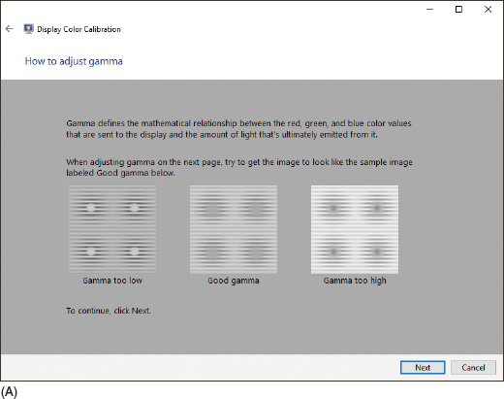
Troubleshooting Video, Monitors, and Projectors (7 of 9)
Figure 6-51 Two screens in the Windows 10 color calibration wizard (A)

Slide 57
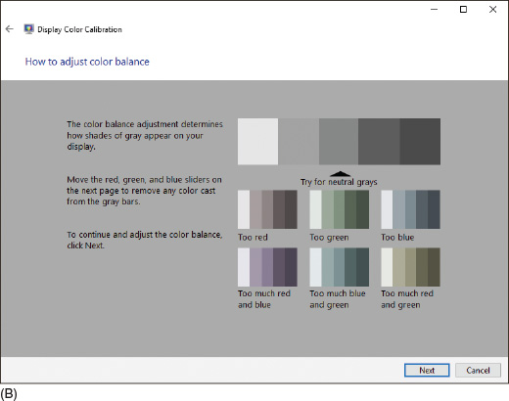
Troubleshooting Video, Monitors, and Projectors (8 of 9)
Figure 6-51 Two screens in the Windows 10 color calibration wizard (B)

Slide 58
Troubleshooting Video, Monitors, and Projectors (9 of 9)
Cannot Connect To External Monitor or Projector
Try the following solutions:
Make sure the monitor or projector is getting power
Check the connection at both ends of the video cable
Is the monitor or projector turned on?
Use the function keys on a laptop to toggle between the laptop display and the external monitor or projector
Try using a different video cable
Try using a different video connection if the laptop and monitor have another option available
If the projector shuts off unexpectedly, it might have entered sleep mode due to inactivity

Slide 59
Video System in a Laptop (1 of 5)
If LCD panel shows a black screen but power light is on:
Look for an LCD cutoff switch or button on laptop
Try to use the video port on the laptop to connect to an external monitor
If external monitor does work, problem is with the LCD panel assembly
Will need to replace inverter or LCD panel

Slide 60
Video System in a Laptop (2 of 5)
Flickering, Dim, or Otherwise Poor Video
Tips to solve problems with bad video:
Verify Windows display settings
Adjust the brightness
Update the video drivers
If the cursor drifts on the screen when the mouse or touch pad isn’t being used, try using a different port on the computer or replacing the batteries in the mouse
A flickering screen can be caused by bad video drivers, a low refresh rate, a bad inverter, or loose connections inside the laptop

Slide 61
Video System in a Laptop (3 of 5)
Replace the LCD Panel in a Laptop
If LCD display is entirely black, replace LCD assembly
If LCD display is dim, the video inverter might be the problem
Check with manufacturer before replacing the LCD panel
General directions to replace an LCD panel:
Remove AC adapter and battery pack
Remove the upper keyboard bezel and possibly, the keyboard
Remove screws holding hinge in place and remove hinge cover
Remove screws holding LCD panel to the laptop
Remove LCD panel from the laptop
Remove screws holding the top cover and LCD panel
Disconnect old inverter and install the new one
Reattach LCD panel assembly to the laptop

Slide 62
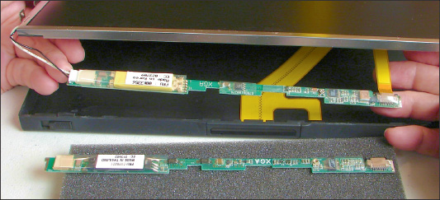
Video System in a Laptop (4 of 5)
Figure 6-60 The inverter is exposed and is compared with the new one

Slide 63
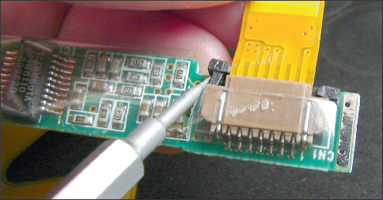
Video System in a Laptop (5 of 5)
Figure 6-61 Lift up on the ZIF connector locking mechanism before removing the ribbon cable

Slide 64
Customizing Computer Systems
Important principles when customizing a system to meet customer needs:
Meet application requirements
Balance functionality and budget
Consider hardware compatibility

Slide 65
Graphics or CAD/CAM Design Workstation (1 of 2)
Graphics-intensive, advanced applications perform complex calculations, use large and complex files, and can benefit from the most powerful workstations
Because 3D graphics is a requirement, a high-end or ultra-high-end video card is needed
Requirements for high-end workstations:
Motherboard that provides at least dual channels for memory and plenty of memory slots, and generous amounts of RAM
Powerful multicore processor with a large CPU cache
Fast hard drives with plenty of capacity
High-end video card

Slide 66
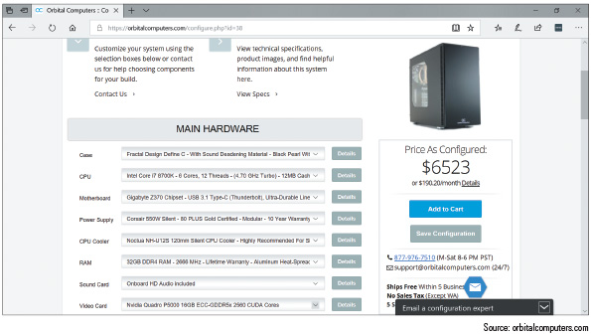
Graphics or CAD/CAM Design Workstation (2 of 2)
Figure 6-62 A high-end CAD workstation customized for maximum performance

Slide 67
Audio and Video Editing Workstation (1 of 2)
Audio- and video-editing applications are not usually as power-hungry as CAD/CAM and graphics applications
You can get by with a less expensive graphics card and processor
What you need for a mid-range to high-end audio/video editing workstation:
Core i7 equivalent or higher processor
High-end motherboard
At least 16 GB of RAM
Video card with a GeForce GTX graphics processor or better
Audio card for higher-quality sound output
Maximum storage space
Double-sided, dual-layer DVD burner and possibly a Blu-ray burner

Slide 68
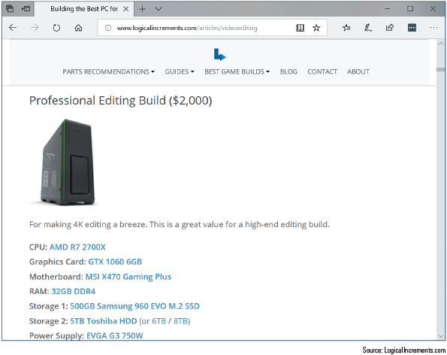
Audio and Video Editing Workstation (2 of 2)
Figure 6-64 This mid-range video-editing workstation uses a Core i7 processor and GTX graphics processor

Slide 69
Gaming PC (1 of 2)
Gaming computers benefit from a powerful multicore processor designed for gaming, a high-end video card, and a high-definition sound card
Gamers might want to overclock their CPUs or use dual video cards
Take extra care to make sure the cooling methods are adequate
Most gaming computers use onboard surround sound
Or you can use a sound card to improve sound

Slide 70
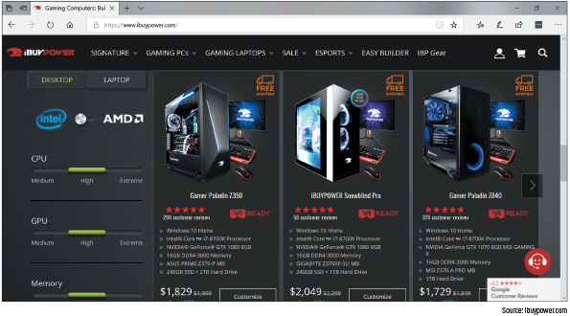
Gaming PC (2 of 2)
Figure 6-65 A group of Intel Core i7 gaming PCs

Slide 71
NAS (Network Attached Storage) Device (1 of 2)
NAS devices can be used to serve up files and to stream media files and movies to client computers
Features and hardware you need to consider when customizing a NAS device:
Processor with moderate power
RAID array
Appropriately sized chassis
Gigabit NIC
Media streaming capability

Slide 72
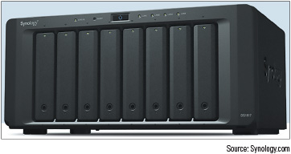
NAS (Network Attached Storage) Device (2 of 2)
Figure 6-66 An eight-bay NAS device

Slide 73
Chapter Summary (1 of 3)
Adding new devices to a computer require installing hardware and software
Use Device Manager to manage hardware devices and solve problems with them
Wired data transmission types include USB, eSATA, Thunderbolt, and Lightning
Wireless data transmission types include Wi-Fi, Bluetooth, and NFC
USB connectors include A-Male, B-Male, Mini-B, Micro-B, and USB-C
Popular I/O ports on a motherboard include eSATA and USB
Video ports that a video card or motherboard might provide are VGA, DVI-I, DVI-D, DisplayPort, HDMI, HDMI mini, and multipurpose Thunderbolt ports

Slide 74
Chapter Summary (2 of 3)
When installing devices, use 32-bit drivers for a 32-bit OS and 64-bit drivers for a 64-bit OS
A touch screen is likely to use a USB port
Biometric input devices collect biological data in order to authenticate access to a system
A KVM switch lets you use one keyboard, monitor, and mouse with multiple computers
Generally, Windows detects new adapter cards and installs appropriate drivers
Types of monitors include LCD and OLED
Use the Windows 10 Settings app or the Windows 8/7 Screen Resolution window to configure monitor resolution and configure dual monitors

Slide 75
Chapter Summary (3 of 3)
Use Device Manager to update drivers on I/O devices giving trouble
Video problems can be caused by the monitor, video cable, video card, onboard video, video drivers, or Windows display settings
A few dead pixels on an LCD monitor screen are considered acceptable by the manufacturer
Artifacts on the monitor screen can be caused by hardware, software, overheating, or overclocking
As a technician, you might be called on to customize a system for a customer
A high-end video card is a requirement in a graphics, CAD/CAM, or video-editing workstation, or for a gaming PC

